Slide 1
Principal Component Analysis
(PCA)
Peng Wang

Slide 2
Outline:
Introduction
Formulation
Implementation
Extension

Slide 3
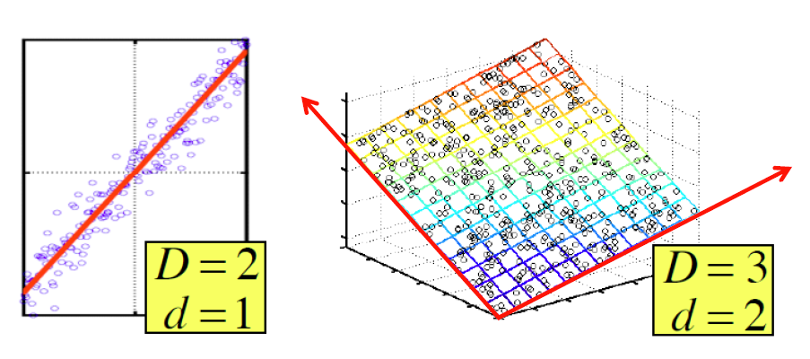
Introduction
Definition: A statistical procedure that uses an orthogonal transformation to convert a set of observations of possibly correlated variables into a set of values of linearly uncorrelated variables called principal components.
d = 2
k = 1
d = 3
k = 2
PCA tries to find the directions of maximum variance (direction of orthogonal axes or principal components) in data and projects it onto a new subspace with lower dimension than the original one.

Slide 4
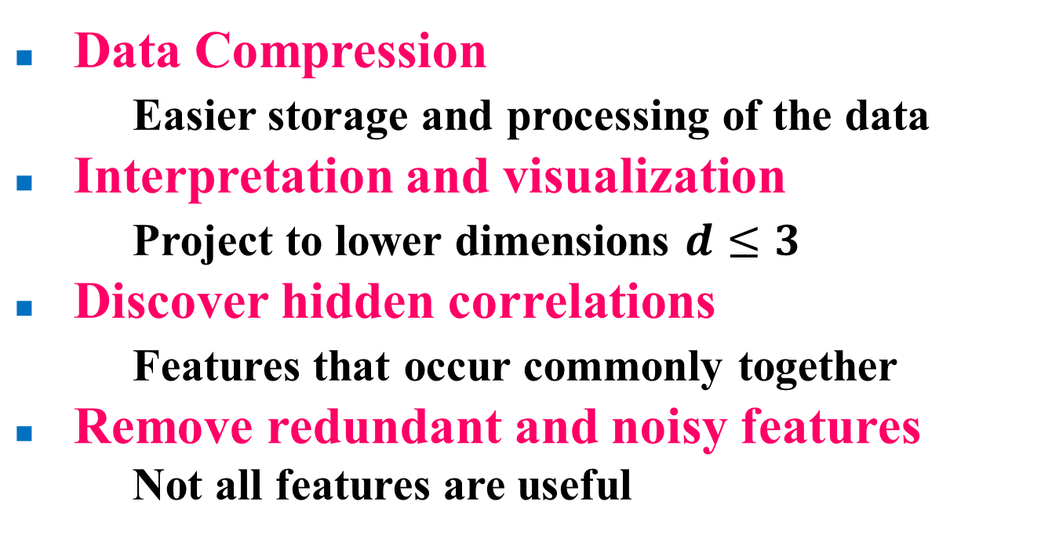
Motivation
Data Compression
Easier storage and processing of the data
Interpretation and visualization
Project to lower dimensions $d≤3$
Discover hidden correlations
Features that occur commonly together
Remove redundant and noisy features
Not all features are useful

Slide 5

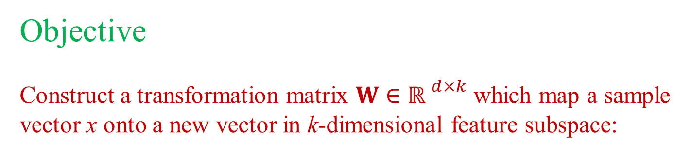
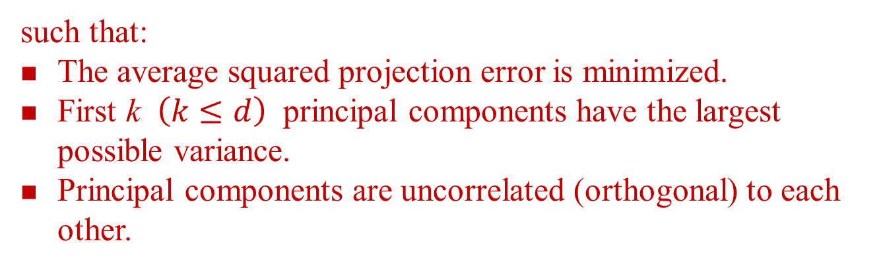


Formulation
Objective
Construct a transformation matrix $W∈{ℝ }^{d×k}$ which map a sample vector x onto a new vector in k-dimensional feature subspace:
$$x W$$
$$x= \left[x_{1},x_{2}, … ,x_{d}\right], x∈{ℝ }^{d×1}$$
$$z= \left[z_{1},z_{2}, … ,z_{d}\right], z∈{ℝ }^{k×1}$$
such that:
The average squared projection error is minimized.
First k $\left(k≤d\right)$ principal components have the largest possible variance.
Principal components are uncorrelated (orthogonal) to each other.

Slide 6


Formulation
PCA
x₂
z
y
x₁
x
Reduce data from 2D to 1D
Linear regression
$$x^{(i)}∈{ℝ }^{2}$$
$$z^{(i)}∈ℝ$$
z

Slide 7



Algorithm
1. Standardize the d-dimensional dataset.
Training set: $x^{(1)},x^{(2)}, …,x^{\left(m\right)} x^{(i)}∈{ℝ }^{1×d}$
Normalize each feature
where
2. Construct the covariance matrix.
$$Σ∈{ℝ }^{d×d}$$
3. Computer the eigenvalues and eigenvectors.
$$\left[A, V\right]=eig(Σ)$$
$$A, V∈{ℝ }^{d×d}$$

Slide 8







Algorithm
4. Select top k eigenvectors to construct projection matrix W.
Top k eigenvectors
$$W∈{ℝ }^{d×k}$$
corresponds to the
k largest eigenvalues
5. Project into the k-dimensional feature subspace.
$$z^{(i)}=x^{(i)}W$$
$$z^{(i)}∈{ℝ }^{1×k}$$
for $i=1, …, m$
*6. Reconstruction from compressed representation.
$${\overline{x}}^{(i)}=z^{(i)} W^{T}$$
$${\overline{x}}^{(i)}∈{ℝ }^{1×d}$$
for $i=1, …, m$
Average squared projection error
Best Low Rank Approx:

Slide 9




Algorithm
Reconstruct from compressed representation
x₂
z
x₂
z
x₁
x₁
$$z^{(i)}∈ℝ$$
$${\overline{x}}^{(i)}∈{ℝ }^{2}$$
$$z^{(i)}=x^{(i)}W$$
$${\overline{x}}^{(i)}=z^{(i)} W^{T}$$
z

Slide 10
Algorithm
Choosing k (number of principal components)
Typically, choose k to be the smallest value so that
is the threshold for how much variance is retained or explained
θ ~ 90%, 95%, 99%
Equivalently, use the eigenvalue matrix
Start trying k = 1, 2, .....
Until the equation is satisfied

Slide 11
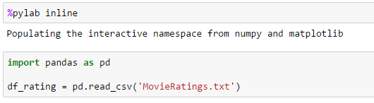
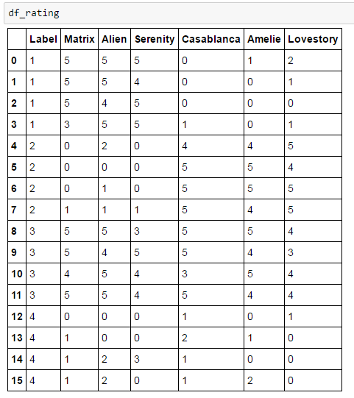
Implementation
Following each step in the algorithm to implement PCA in python.
Data set: Movie ratings by users
Rating ranges from 0 to 5 star.
Split users into several groups by label, each group has distinct rating patterns.

Slide 12

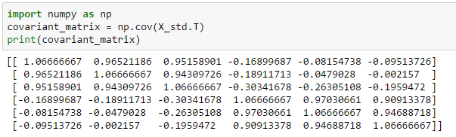
Implementation
1. Standardize original dataset.
Note that PCA is an unsupervised method, so the label is ignored.
2. Construct the covariance matrix.
Note numpy.cov() method take each observation as a column vector.

Slide 13
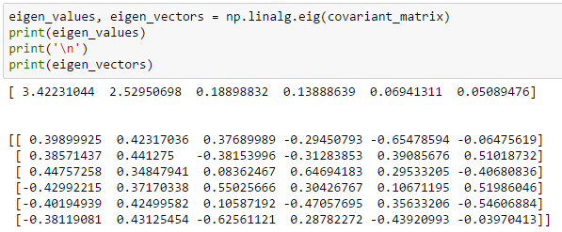
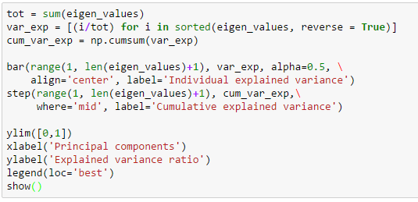
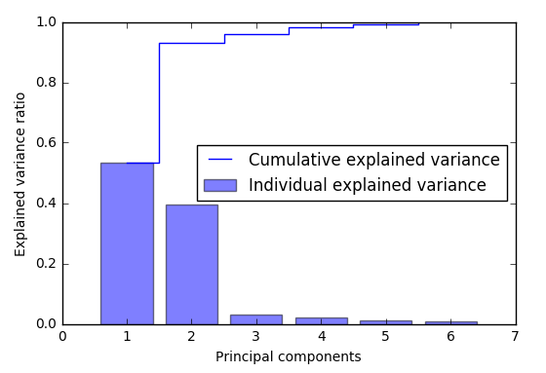
Implementation
3. Computer the eigenvalues and eigenvectors.

Slide 14
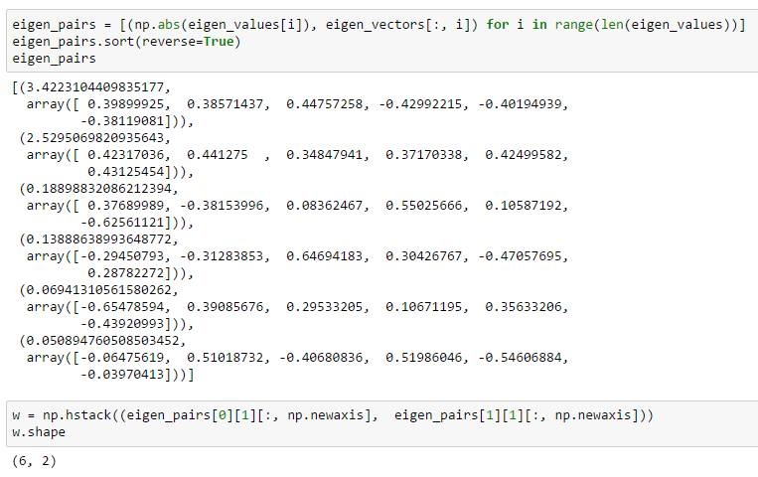
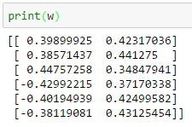
Implementation
4. Select top k eigenvectors to construct projection matrix W.

Slide 15
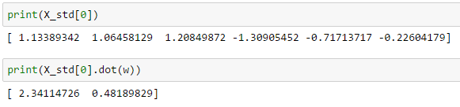
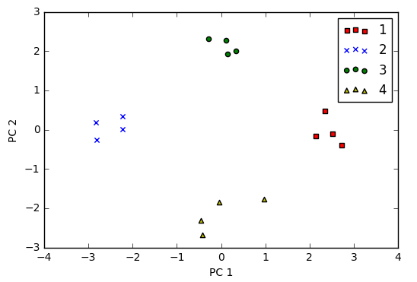
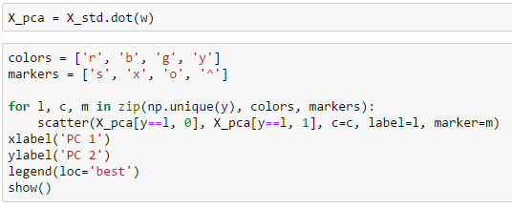
Implementation
5. Project into the k-dimensional feature subspace.
Project 6-dimensional data into 2-dimensional subspace and visualize it.
PC1 represents user preference for various movie genre. (Scientific, Romantic)
PC2 represents the averaged user ratings for all movies. (Generous, Critical)

Slide 16
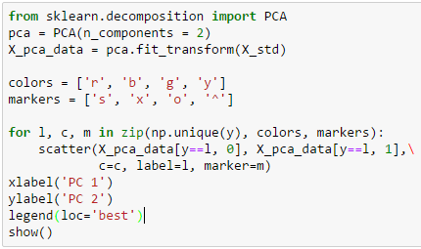
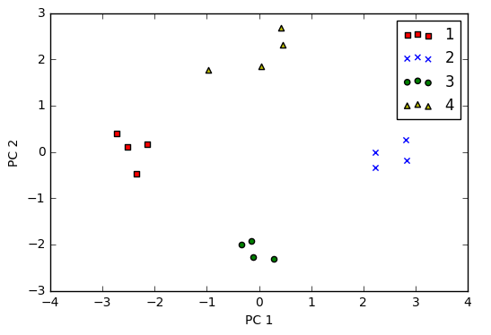
Implementation
Directly apply PCA transformation from sklearn.decompositoin
Both PC1 and PC2 are flipped since the eigenvectors can take opposite directions.
Scikit-learn's transformer classes makes it simpler and easier to implement PCA while harder to debug.

Slide 17
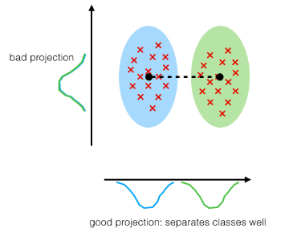
Extension
Linear Discriminant Analysis (LDA)
Find the component axes for maximizing class separability (supervised method)
t-distributed Stochastic Neighbor Embedding (TSNE)
Reduce the dimension while preserving the similarities between data points for visualization.
Implement Barnes-Hut approximations to apply on large datasets.

Slide 18
Thank you!
Questions?

